Slide 1




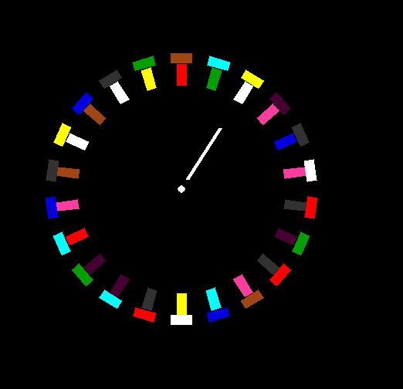

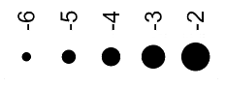


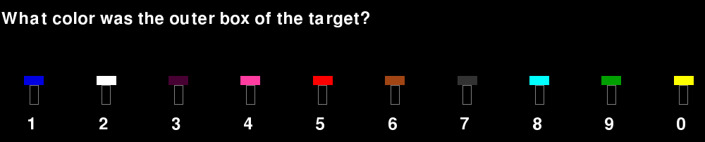

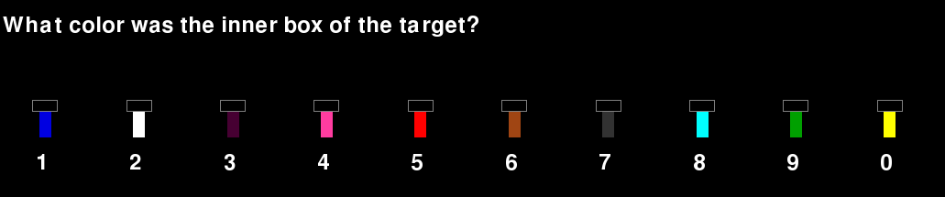





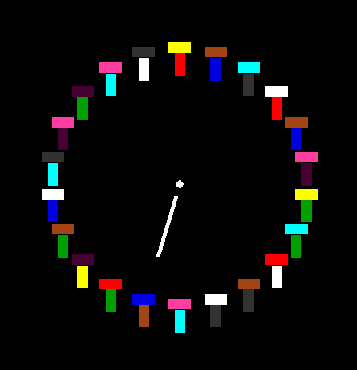

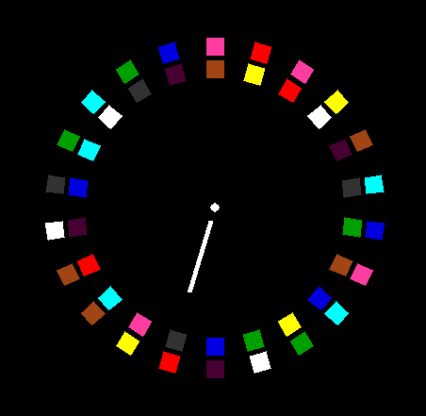



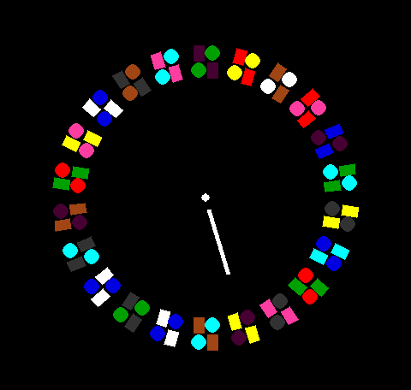
Response patterns from sampling
Hierarchical binding and illusory conjunctions of multi-part objects
Anina Rich, Cory A. Rieth & Edward Vul
anina.rich@mq.edu.au, coryrieth@pacific-science.com, evul@ucsd.edu
Task
Data Collection and presentation
Detailed results
Identify the two colors of the two parts of a cued object in a briefly presented circular array of similar objects
Marker size represents log response proportion of the color in that position
Fixation Point
400ms
Accuracy | P(whole) | P(Part) | P(Col.)
0.13 | 0.09 | 0.01 | 0.43
I
0.002
0.007
0.018
0.050
0.135
Object Array
100ms
Reports of part A color for part A
Colors for two adjacent objects to either side of the target object were unique.
On each trial, position and part of the color response was coded
Response collection
Presented until response
color and part order randomized
Accuracy | P(whole) | P(Part) | P(Col.)
0.13 | 0.09 | 0.01 | 0.43
Accuracy | P(whole) | P(Part) | P(Col.)
0.13 | 0.09 | 0.01 | 0.43
Reports of part B color for part A
I
Time
True target and adjacent distractors
Each participants completed 400 trials.
Part types manipulated between subjects.
All objects were oriented radially from the center, with the exception of those outlined on the far right
Color randomized on each trial
I
I
Accuracy | P(whole) | P(Part) | P(Col.)
0.13 | 0.09 | 0.01 | 0.43
Accuracy | P(whole) | P(Part) | P(Col.)
0.13 | 0.09 | 0.01 | 0.43
Reports of part A color for part B
Reports of part B color for part B
Reports of part B color for part B
Predicted responses from sampling at different levels
Model results
Accuracy | P(whole) | P(Part) | P(Col.)
0.13 | 0.09 | 0.01 | 0.43
Accuracy | P(whole) | P(Part) | P(Col.)
0.13 | 0.09 | 0.01 | 0.43
Sample whole objects
Sample both parts
(or one part and correct color)
Sample two colors
Accuracy | P(whole) | P(Part) | P(Col.)
0.13 | 0.09 | 0.01 | 0.43
Accuracy | P(whole) | P(Part) | P(Col.)
0.13 | 0.09 | 0.01 | 0.43
These response patterns are build into a probabilistic response model
The model responses are based on responses given a whole object sample, two independent part samples, and/or two independent color samples
Model assumes whole object, part, and color samples are generated from discrete Laplace distributions centered on the correct target
Sample one part
(guess other)
Sample one color
(respond twice)
Model fit to participant data to obtain estimates of the probability of a whole object sample, a part sample, or a color sample for each object type
Accuracy | P(whole) | P(Part) | P(Col.)
0.13 | 0.09 | 0.01 | 0.43
Accuracy | P(whole) | P(Part) | P(Col.)
0.13 | 0.09 | 0.01 | 0.43
Notes:
The attentional blink (AB) and repetition blindness (RB) are detriments in accuracy during rapid serial visual presentation following a task-relevant stimulus. In AB paradigms, identification of a second target appearing from two to five items after a first is impaired. RB refers to a tendency to miss repetitions of stimuli when the repetition occurs shortly after the initial stimulus in an RSVP stream. We seek to understand AB and RB at a computational level through rational inference. We propose that RB and AB are consequences of priors about the temporal distribution of event transitions, and the probability of task-relevant events. We show that rational inference using these priors reproduces the basic effects and time courses of both RB and AB, and the patterns of specific intrusion errors during AB. This framework also explains related effects such as order confusions, the influence of pre-cueing, and spreading the sparing.

Slide 2
Response patterns from sampling
Hierarchical binding and illusory conjunctions of multi-part objects
Anina Rich, Cory A. Rieth & Edward Vul
anina.rich@mq.edu.au, coryrieth@pacific-science.com, evul@ucsd.edu
Task
Data Collection and presentation
Detailed results
Identify the two colors of the two parts of a cued object in a briefly presented circular array of similar objects
Marker size represents log response proportion of the color in that position
Fixation Point
400ms
Accuracy | P(whole) | P(Part) | P(Col.)
0.13 | 0.09 | 0.01 | 0.43
I
0.002
0.007
0.018
0.050
0.135
Object Array
100ms
Reports of part A color for part A
Colors for two adjacent objects to either side of the target object were unique.
On each trial, position and part of the color response was coded
Response collection
Presented until response
color and part order randomized
Accuracy | P(whole) | P(Part) | P(Col.)
0.13 | 0.09 | 0.01 | 0.43
Accuracy | P(whole) | P(Part) | P(Col.)
0.13 | 0.09 | 0.01 | 0.43
Reports of part B color for part A
I
Time
True target and adjacent distractors
Each participants completed 400 trials.
Part types manipulated between subjects.
All objects were oriented radially from the center, with the exception of those outlined on the far right
Color randomized on each trial
I
I
Accuracy | P(whole) | P(Part) | P(Col.)
0.13 | 0.09 | 0.01 | 0.43
Accuracy | P(whole) | P(Part) | P(Col.)
0.13 | 0.09 | 0.01 | 0.43
Reports of part A color for part B
Reports of part B color for part B
Reports of part B color for part B
Predicted responses from sampling at different levels
Model results
Accuracy | P(whole) | P(Part) | P(Col.)
0.13 | 0.09 | 0.01 | 0.43
Accuracy | P(whole) | P(Part) | P(Col.)
0.13 | 0.09 | 0.01 | 0.43
Sample whole objects
Sample both parts
(or one part and correct color)
Sample two colors
Accuracy | P(whole) | P(Part) | P(Col.)
0.13 | 0.09 | 0.01 | 0.43
Accuracy | P(whole) | P(Part) | P(Col.)
0.13 | 0.09 | 0.01 | 0.43
These response patterns are build into a probabilistic response model
The model responses are based on responses given a whole object sample, two independent part samples, and/or two independent color samples
Model assumes whole object, part, and color samples are generated from discrete Laplace distributions centered on the correct target
Sample one part
(guess other)
Sample one color
(respond twice)
Model fit to participant data to obtain estimates of the probability of a whole object sample, a part sample, or a color sample for each object type
Accuracy | P(whole) | P(Part) | P(Col.)
0.13 | 0.09 | 0.01 | 0.43
Accuracy | P(whole) | P(Part) | P(Col.)
0.13 | 0.09 | 0.01 | 0.43
Notes:
The attentional blink (AB) and repetition blindness (RB) are detriments in accuracy during rapid serial visual presentation following a task-relevant stimulus. In AB paradigms, identification of a second target appearing from two to five items after a first is impaired. RB refers to a tendency to miss repetitions of stimuli when the repetition occurs shortly after the initial stimulus in an RSVP stream. We seek to understand AB and RB at a computational level through rational inference. We propose that RB and AB are consequences of priors about the temporal distribution of event transitions, and the probability of task-relevant events. We show that rational inference using these priors reproduces the basic effects and time courses of both RB and AB, and the patterns of specific intrusion errors during AB. This framework also explains related effects such as order confusions, the influence of pre-cueing, and spreading the sparing.

